Slide 1


Seminar on Case Study of Emerging Area of Technology Progress Report on Topic: “ Fitness Tracker”
Students Name, Enrollment No. Branch & Section:
Aman Goel, 10817711922, AI&DS(B)
Jeetender singh , 10417711922, AI&DS(B)
Mohd. Sameed Qadri, 09817711922, AI&DS(B)
Supervisor: Dr Anshula

Slide 2
Index of Contents
Introduction & Motivation
Problem Statement
Background Study
Technology Stack
Research Work Progress
Methodology
Conclusion and Future scope
References

Slide 3
1. Introduction & Motivation
In today's fast-paced world, prioritizing health and fitness can be a daunting task. With demanding schedules, tempting distractions, and a myriad of conflicting information, many individuals struggle to maintain consistent exercise routines and make healthy lifestyle choices. However, investing in one's health is more important than ever, as it directly impacts overall well-being, productivity, and quality of life.
Motivating individuals to embark on a journey toward better health and fitness is not just about aesthetics; it's about empowering people to live their best lives. By adopting regular exercise and nutritious eating habits, individuals can enhance their physical strength, mental clarity, and emotional resilience. Moreover, a healthy lifestyle reduces the risk of chronic diseases, boosts immune function, and fosters longevity..
Yet, despite the myriad of benefits, sustaining motivation for fitness endeavors remains a significant challenge. Many struggle with finding the time, staying consistent, and overcoming obstacles such as lack of knowledge or support. This is where technology can play a transformative role.

Slide 4
2. Problem Statement
Many individuals struggle to maintain consistent exercise routines and healthy lifestyles due to various reasons such as lack of motivation, time constraints, and difficulty tracking progress. Existing fitness sites often fail to address these challenges effectively, resulting in user disengagement and limited long-term success. Therefore, there is a need for a comprehensive fitness site that not only provides personalized workout plans and nutrition guidance but also offers motivation, accountability, and intuitive tracking features to help users stay committed and achieve their health and fitness goals.

Slide 5
3. Background Study
Before developing a fitness site, conducting thorough background research is essential to understand the user needs, existing solutions, and emerging trends. Here are some key areas to focus on during the background study:
Market Analysis: Identify the target audience and analyze the market trends.
User need assessment: Identify common obstacles that prevent individuals from sticking to their fitness routines, such as lack of time, motivation, knowledge, or social support.
Explore integration possibilities: Investigate potential integrations with wearable devices, health trackers, nutrition databases, social media platforms, and other third-party services.
Consider data privacy and security: Understand the legal and ethical considerations related to storing and handling users' health data to ensure compliance with regulations like GDPR and HIPAA.
Study behavioral psychology: Explore principles of behavior change, motivation, habit formation, and goal setting to design features that encourage sustained engagement and adherence.

Slide 6
3. Background Study
Research workout plans: Curate a variety of workout routines tailored to different fitness levels, goals, and preferences, including strength training, cardio, yoga, HIIT, etc.
Explore nutrition guidance: Provide evidence-based nutritional information, meal plans, recipes, and calorie tracking tools to support users' dietary goals and optimize performance.
Consider multimedia resources: Incorporate videos, tutorials, audio guides, and written content to enhance users' learning experience and ensure proper form and technique.
Leverage gamification: Learn from gamification techniques to incorporate elements like rewards, challenges, progress tracking, and social interactions to make the fitness journey more engaging and enjoyable.
Leverage gamification: Learn from gamification techniques to incorporate elements like rewards, challenges, progress tracking, and social interactions to make the fitness journey more engaging and enjoyable.

Slide 7








4. Technology Stack
Python

Slide 8
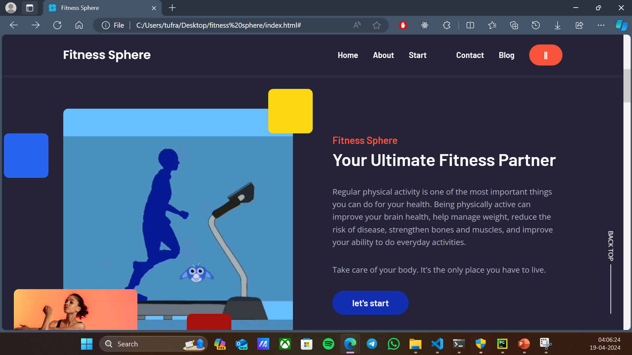
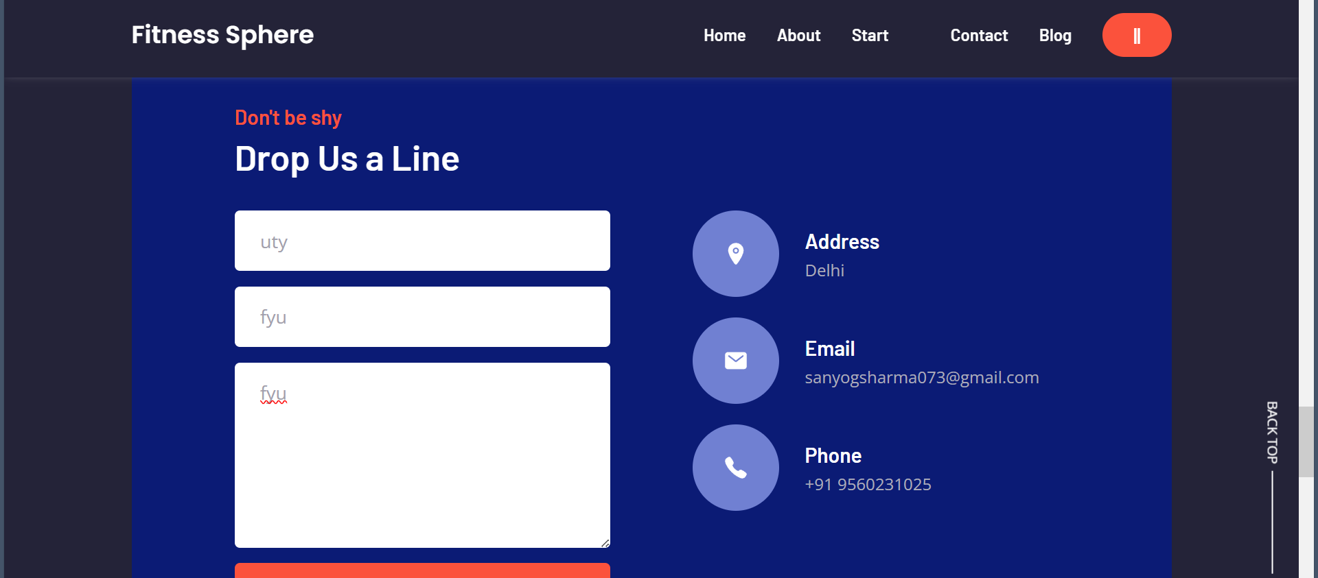
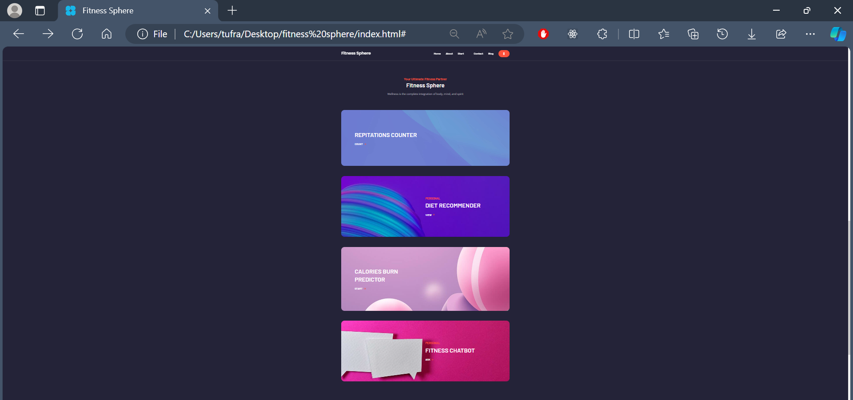
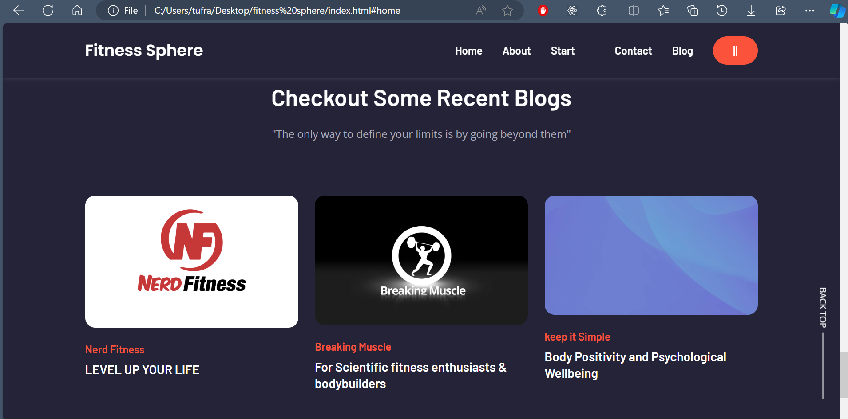
5. Research work Progress

Slide 9
5. Methodology
choose a Platform: Select a website builder or CMS (e.g., WordPress, Wix, Squarespace) that suits your needs.
Select a Domain Name: Choose a domain name that is easy to remember and reflects your brand.
Pick a Template: Choose a template that aligns with your fitness brand and is user-friendly.
Customize Your Site: Add your logo, choose color schemes, and customize the layout to match your brand identity.
Create High-Quality Content: Develop content that showcases your services, expertise, and client testimonials. Include workout videos, blog posts, and success stories.
.

Slide 10
5. Methodology
Implement Essential Features: Add features like online booking, class schedules, a contact form, and a blog.
Optimize for SEO: Use search engine optimization techniques to improve your website's visibility on search engines.
Test and Launch: Test your website thoroughly to ensure everything works correctly. Then, launch your site and promote it through social media and other channels.
Maintain and Update: Regularly update your content, add new features, and ensure your website remains secure and functional.

Slide 11
7. Conclusion and Future Scope
Integration of Emerging Technologies.
Innovations in Health Monitoring and Tracking.
Enhanced User Engagement and Community Building.
Ethical and Regulatory Considerations.
Globalization and Cultural Adaptation.
Business Models and Monetization Strategies.
Expansion of Personalization and Customization.

Slide 12
8. References
1. Hingle, M. D., Patrick, H., Sacher, P. M., Sweet, C. M., & Evans, M. (2019). Tweets, apps, and pods: Results of the 6-month Mobile Pounds Off Digitally (Mobile POD) randomized weight-loss intervention among adults. *Journal of Medical Internet Research, 21*(1), e11463.
2. Johnson, E. A., Dunn, C. G., Pollock, J. W., & Acosta, A. (2021). Personalized health feedback using real-time wearable sensor data enhances engagement, satisfaction, and long-term exercise adherence. *Journal of Medical Internet Research, 23*(2), e19966.
3. Lee, J., & Kim, D. (2018). Enjoyment and intention to exercise: A study of virtual reality exercisers. *Computers in Human Behaviour, 83*, 17-23.
4. Nguyen, N., Law, R., & Breen, G. M. (2021). The ethics of artificial intelligence in health care: A systematic literature review. *Journal of Medical Internet Research, 23*(4), e27232.
5. Patel, M. S., Asch, D. A., & Volpp, K. G. (2020). Wearable devices as facilitators, not drivers, of health behaviour change. *Journal of the American Medical Association, 323*(5), 459-460.
6. Smith, A., & Tallon, P. (2020). Digital transformation in the fitness industry: A qualitative investigation. *Sport Management Review, 23*(3), 516-530.

Slide 13
THANK YOU

